Slide 1
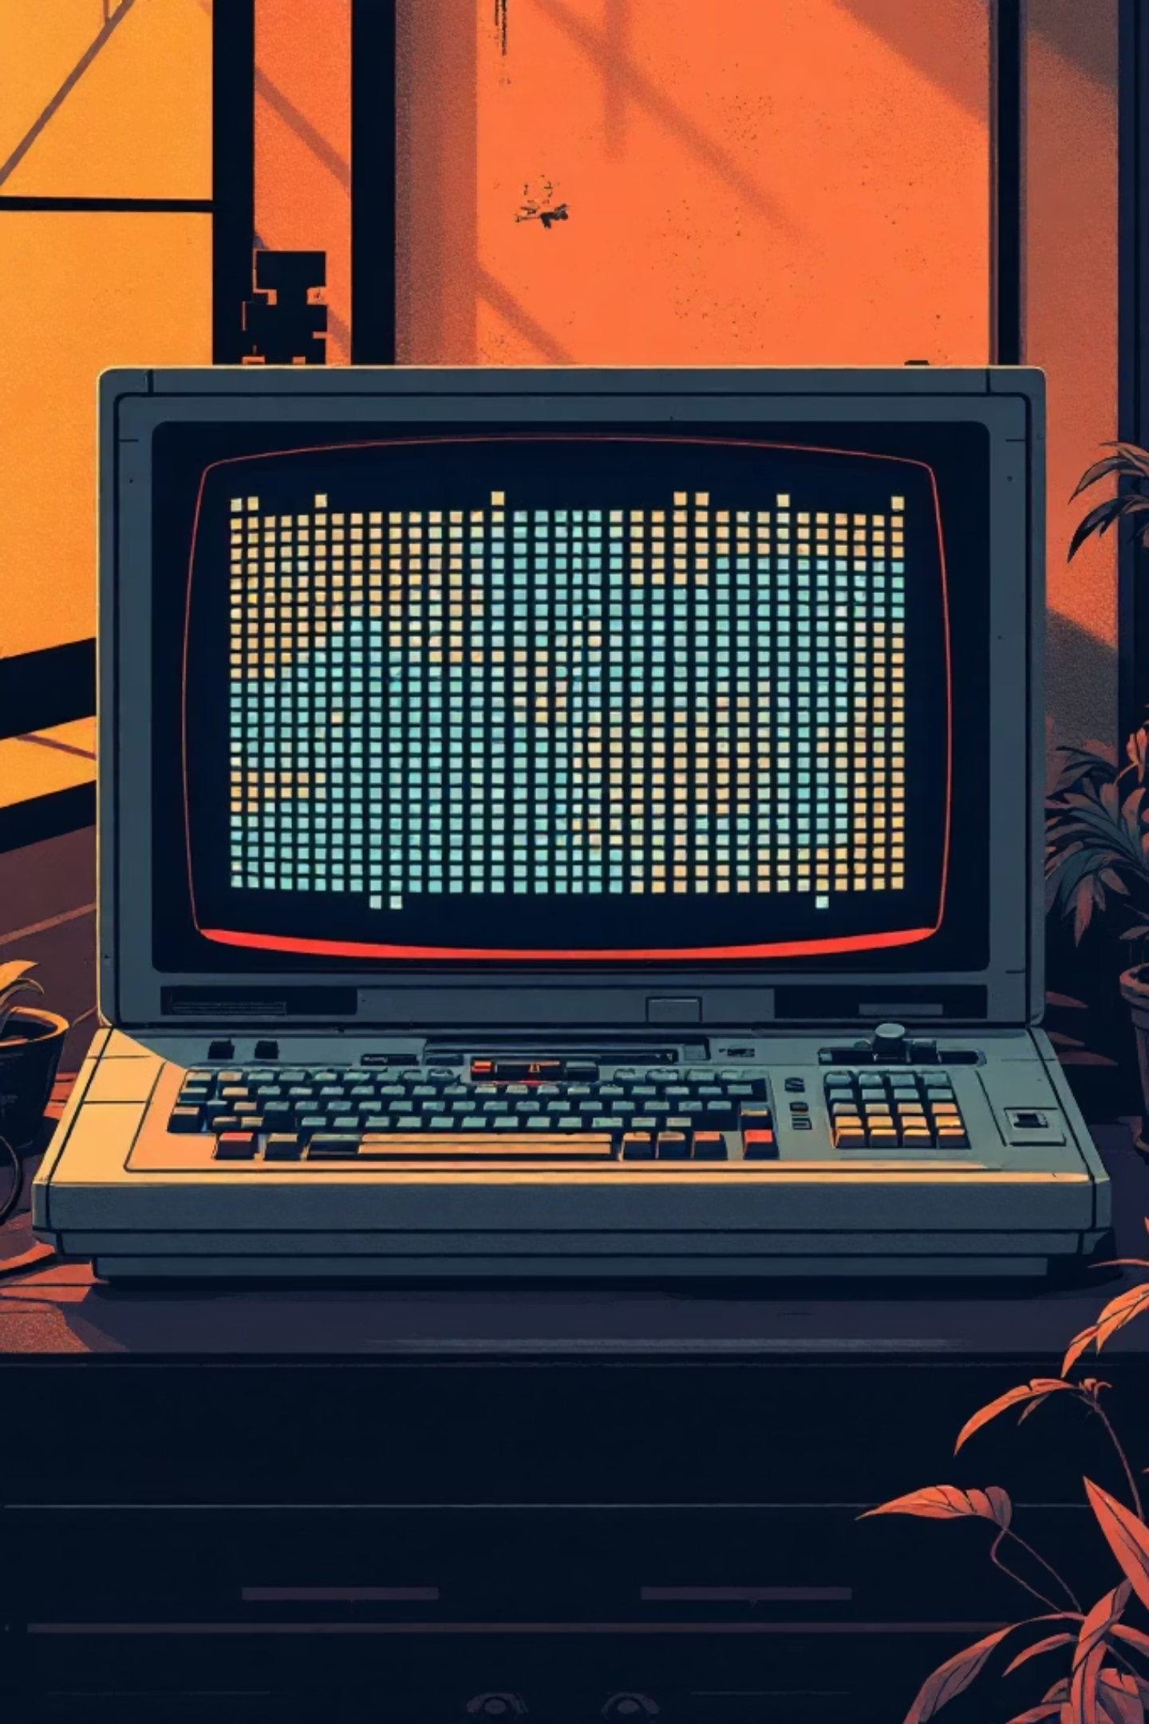
Process Survival Game — Project Report
Operating Systems practical project demonstrating process behavior, resource management, and memory handling via a C-based grid survival game.

Slide 2

Team & Submission
Group Members
Course Details
Muhammad Umer (23010112-005)
Department: BS AI · Section: Blue · Submitted to: Mam Wajeeha
Muhammad Irtisam (23010112-006)
Rizwa Asad (23010112-016)
Date
17/02/2026

Slide 3

Game Environment
The world is a 15×15 grid. Symbols: . = empty, F = food, W = water, # = obstacle, P = player (process).

Slide 4
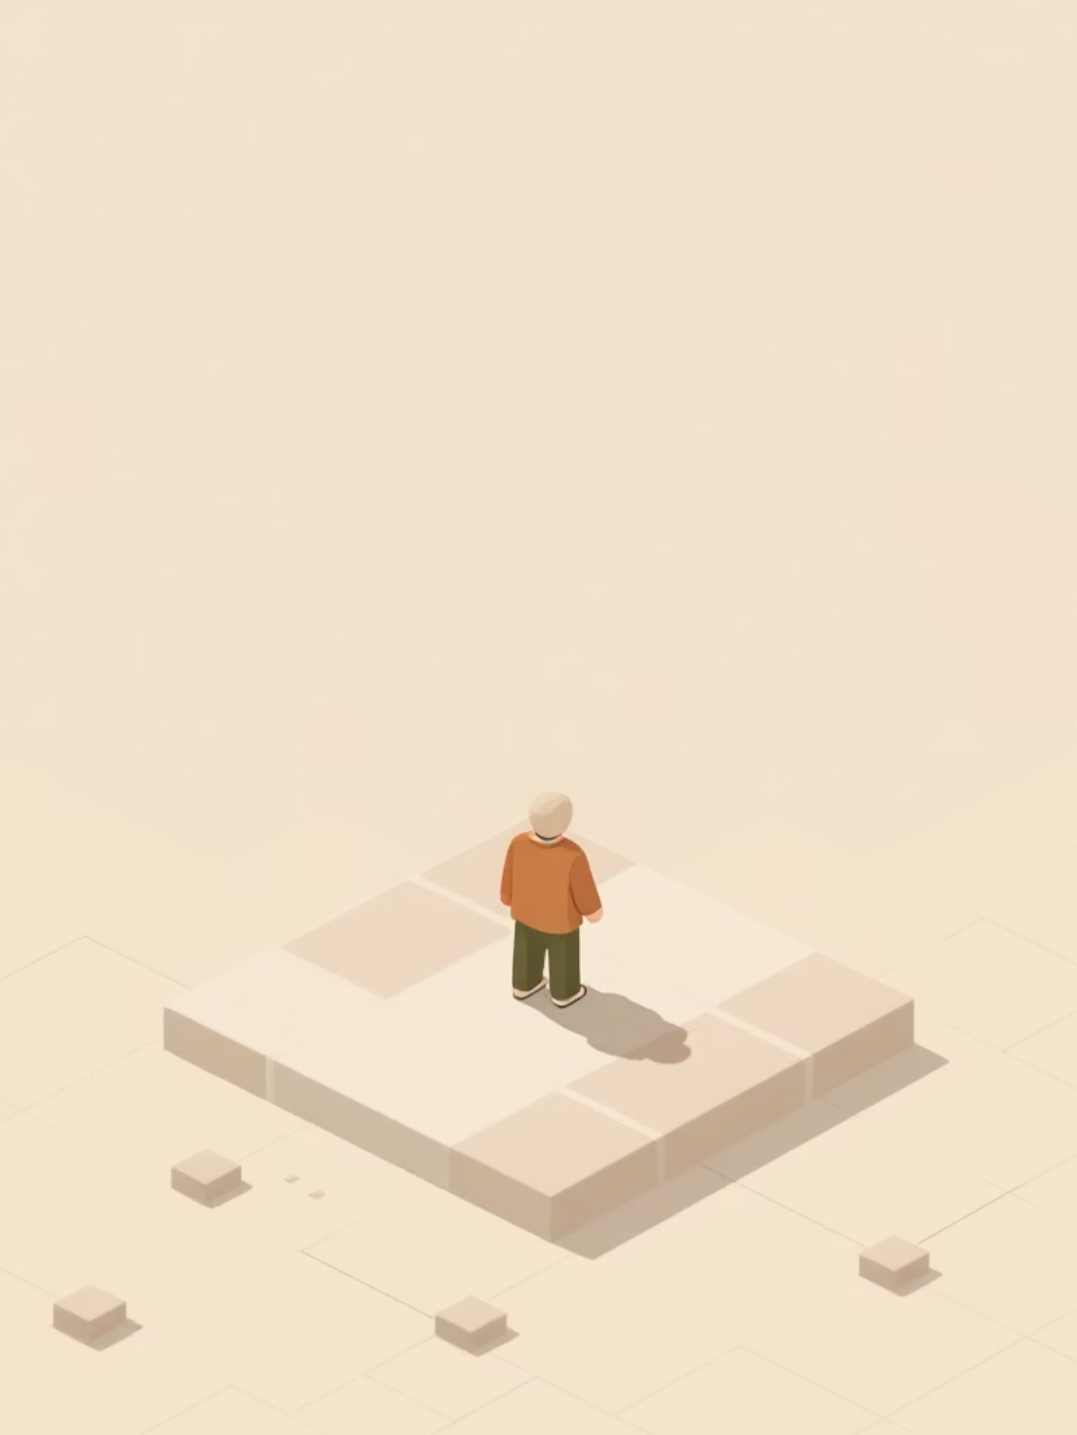
Core Mechanics — Player as a Process
Initial State
Consumption
Food = 30 · Water = 30
Each move consumes 1 food and 1 water
Resources
F adds +10 food, W adds +10 water; consumed resources removed from the grid

Slide 5

Obstacles & Termination
Obstacles (#) represent fatal system errors. Colliding with an obstacle immediately terminates the process—simulating illegal memory access or fatal system calls.

Slide 6
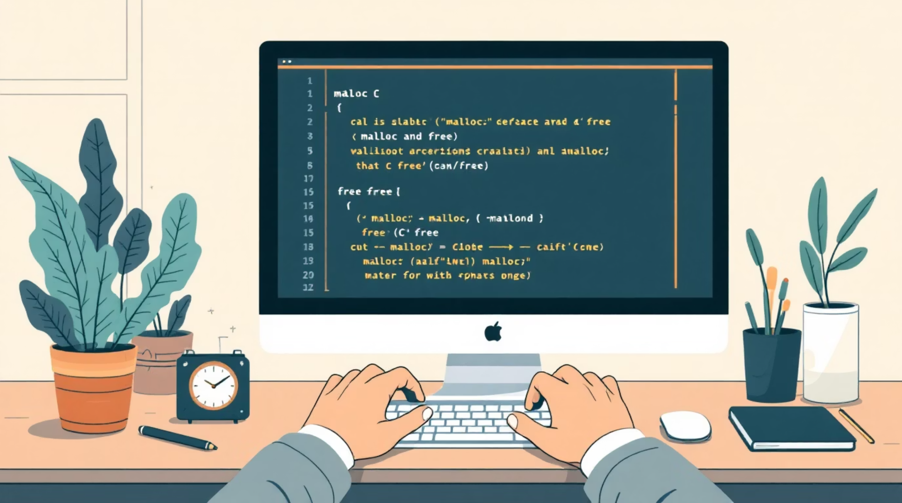
Memory Management
Dynamic Allocation
malloc() used for world and seen grids — demonstrates heap usage
Cleanup
free() used at program end to avoid memory leaks

Slide 7

Process Termination Conditions
Resource Exhaustion
Obstacle Collision
User Quit (q)
Normal Exit
These conditions mirror real OS termination triggers: user request, resource exhaustion, fatal errors, and normal shutdown.

Slide 8
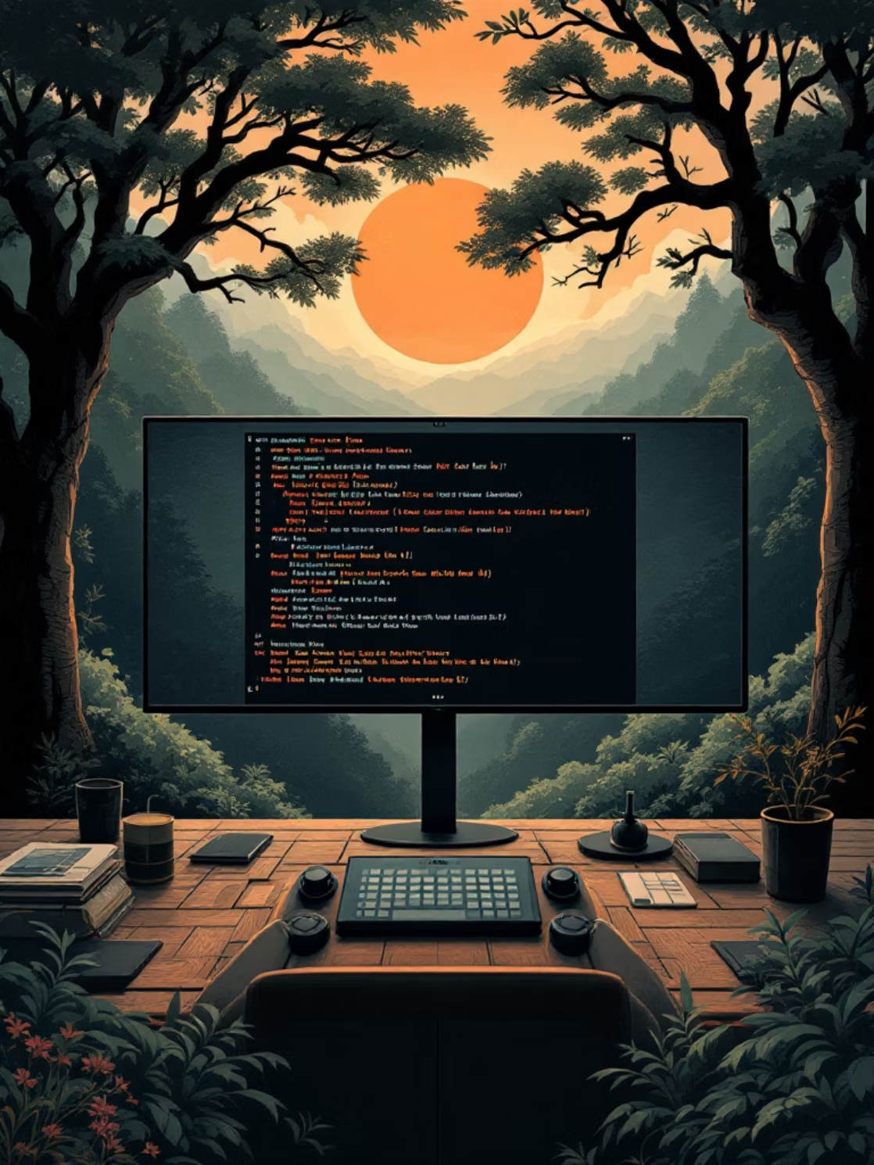
User Controls & Interaction
Key
Action
w
Move up
s
Move down
a
Move left
d
Move right
q
Quit game
Grid refreshes after each move; terminal cleared for real-time feel. Status shows steps, remaining food, and water.

Slide 9




OS Concepts Demonstrated
Process Execution
Resource Allocation
Memory Management
Isolation
Limited visibility models process isolation and seen grid.
Player movement models running processes.
Food and water simulate allocated resources.
malloc/free illustrate heap allocation and cleanup.

Slide 10

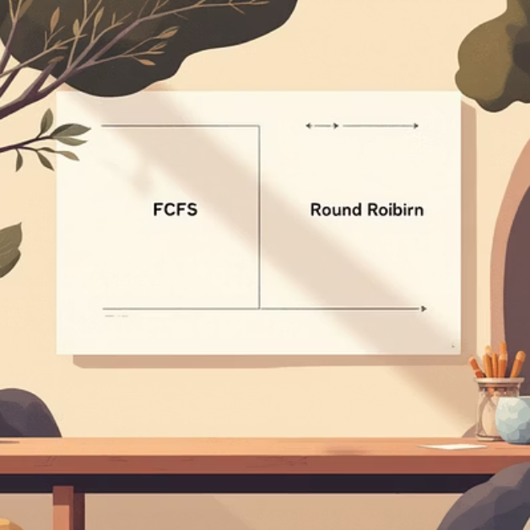

Conclusion & Future Enhancements
Conclusion
Interactive simulation bridges OS theory and practice by modeling lifecycle, resource control, and memory usage.
Future Ideas
Multiple processes, scheduling (FCFS, Round Robin), priority survival, save/load state, and graphical UI.

